Slide 1
Transition Year
Parents Information Evening

Slide 2
What is Transition Year
A highly structured one year school-based programme with a full weekly timetable.
An educational bridge between Junior and Senior Cycle.
Smooth transition to the more independent, self-directed learning required for Senior Cycle.

Slide 3
Benefits of TY
Time to mature
Develop self-awareness, self respect & self esteem.
T.Y. facilitates skills based learning e.g. oral and interpersonal skills.
Opportunity to sample Senior Cycle subjects to inform subject choice decisions.

Slide 4
Our TY Programme
CORE SUBJECTS.
SUBJECT SAMPLING.
TY SPECIFIC SUBJECTS
CALENDAR ACTIVITIES ENHANCE & CONTEXTUALISE LEARNING.

Slide 5
Core Subjects
Irish
English
Maths
Business
German/French
Geography
Music
Religion
Science
History
Home Economics
PE

Slide 6
Subject Sampling
Woodwork
Chinese
Speech & Drama
YSI
Reach Plus

Slide 7
TY Specific Subjects
ECDL
Sign Language
Public Speaking
Driving Campus
Skills
Food Safety
Personal Development

Slide 8
Calendar of activities
Our calendar of activities support, extends & enhances the educational experiences of our Transition Year students beyond the classroom.
Students have the opportunity to learn from the advice and knowledge of guest speakers on myriad careers, 3rd level courses, national & international topics & local expertise.
Activities within the classroom also support the creation of projects, presentations, group work assignments & skills development for Senior Cycle studies.

Slide 9
Bilingual bonding trip to Tramore (Overnight Trip)
Poetry Slam Workshop
Law Workshop
Enterprise Workshop in Springford Hall
Mini Company Competition in Mallow
Bernard Casey Comedy & Irish Workshop
BT Young Scientist
Junk Koture
Sign Language
Chinese
Driver theory & Driver Experience
Food Safety
Personal Development
Debating
DCMUN
YSI
Community Engagement Art Project
Gaisce Adventure Journey (Overnight trip)
First Aid
Various Speakers/workshops throughout the year

Slide 10
Sports Coaching
Houses of the Oireachtas
Engineering your Future TY Programme – http://www.cit.ie/currentnews?id=1244 Applications for this will open in October on the Engineers Ireland website and it is open to male and female TY students (80 students in total) for the week 11th to 15th May 2020.
IWISH Campus Week for female students only:
13th to 17th January 2020. Further information on www.iwish.ie under campus week option. Applications for this will open in October. I will email you once the application process opens.
Cork Electronics Industry Association - run a campus week for TY students http://www.ceia.ie/education-and-schools/transition-year-work-experience-programme/ The application process is now open for this.
Royal College Of Surgeons Ireland - The RCSI Transition Year MiniMed Programme is a major event in the RCSI calendar. Programme 1: Monday 24th February – Wednesday 26th February 2020. Programme 2: Monday 9th March – Wednesday 11th March 2020. Each programme will take place in RCSI, 26 York Street. The programme is designed to give students the opportunity to experience what it is like to train and work as a doctor. The programme consists of lectures, practical’s and real life surgeries via video link to the operating theatre, all of which are carried out by leading professionals in their respective areas.
Nursing Taster Days
TRY Music WIT - The Try Music Student Experience is aimed at students wishing to pursue the BA (Hons) in Music programme at WIT. This is the fifth year of the popular event and students from secondary schools and Colleges of Further Education are invited to experience life as a music student in WIT for one day. During this day, prospective student can do the following: Attend an ensemble of their choice - jazz, guitar, choir, Irish traditional - where they will rehearse a piece with the current students and perform it at the lunchtime concert in the College Street campus Chapel. Workshops will take place on the entrance tests and audition requirements. Spend some time in the recording studio in the afternoon. This is an invaluable experience for prospective students and will give a really important insight into the Music course at the Institute. https://www.wit.ie/events/all_news/try-music-2019

Slide 11
TRY Sport - https://www.wit.ie/events/all_news/try-sport-at-wit-2020
Try Sport gives participants the opportunity to live the life of a student studying health, sport and fitness courses, meet our expert staff .Activities: Strength and Conditioning Introductory Class, Practical Biomechanics Session, Interactive Class - How much do you know about Sport?, Interactive Class - Exploring the Impact of Nutrition on Sport, Talk with Staff and Students – Hear what it’s like to study at WIT. Participants will get an opportunity to talk with current students who will share their insights into the department, courses and life in WIT. Information will also be presented about the varied opportunities that exist for students upon graduation. This one day taster course will provide you with a unique opportunity to test the DSES experience for yourself, giving you confidence in your CAO choice.
This is just a selection of what is available, please go to the qualifax webpage to see a full list of taster days, college open days and various educational days on offer by the colleges. All information in relation the application process for courses can be found here. If you apply and are lucky enough to attend please let us know in school so that the students will not be marked absent.
https://www.qualifax.ie/index.php?option=com_wrapper&view=wrapper&Itemid=22

Slide 12
Work Experience
Gives students an opportunity to sample different jobs.
Provides skills such as team building, communication skills and commercial awareness.
Work experience helps students to decide what to do after school (in 3RD level education, training or work)
Eliminates options which may have appealed.
Students complete a reflective journal of learning whilst on work experience as one of their assessments.
Our dates for work experience are 25th-29th November & 10th – 14th February
We encourage extra work experience, however we would suggest that this would be organised outside school time in order for students to benefit from the programme organised in school.

Slide 13
ASSESSMENT & HOMEWORK.
Homework will be more research, task & skills based but this is equally important in TY.
Portfolio: reflective and evaluative document which builds upon year’s learning experiences inside & outside the classroom.
Peer-assessment through evaluation and discussion of learning outcomes.
Regular written evaluation of activities and learning outcomes from trips.
Examinations in core subjects
Skills assessment – practical demonstrations of learning.
Written /Practical Class tests.
Oral /Aural assessment – beyond just language subjects.
Project work – written and creative - variety.
Interview at the end of the year in May
School based certification at end of Transition Year.

Slide 14
TY Portfolio
As part of Transition Year all students are required to compile a portfolio.
The portfolio is a reflective and evaluative document which builds upon each students’ individual year’s learning experiences inside & outside the classroom.
Students will log their learning on core, specific and sampling subjects along with workshops attended and excursions.

Slide 15
TY Credit System
Transition Year is assessed through a credit system.
Credits will we rewarded for completed assignments in all subjects, attendance, punctuality and uniform, participation in skills, participation in Gaisce, extra-curricular activities, a completed portfolio and an interview at the end of transition year.
The Credit awards are broken down as follows:
340 - 300 = Distinction
280 - 339 = Higher Merit
220 – 279 = Merit
160 – 219 = Pass
0 – 160 = Participation
All students will receive a certificate with their achievement along with a report of their credits at the graduation ceremony.

Slide 16
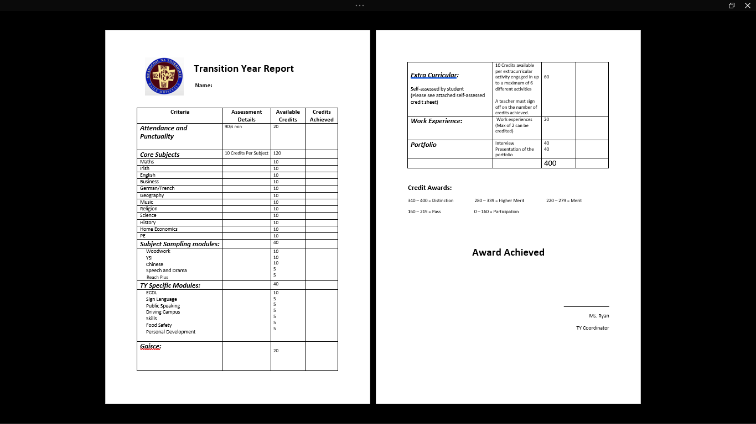
TY Credit System

Slide 17
Communication
All communication will be done through student email – this is to foster independence and encourage self management.
If you have any queries please do not hesitate to call the school and I will return your call as soon as possible.

Slide 18
Contact Information
School Phone Number: 025 24394
School Email: office@presmitchelstown.ie

